Slide 1
Analysis of Tobacco Use In The US
Zalak Gajjar, Nick Miller, Summer Harik, Anna Reed

Slide 2
Research Questions
What are the most popular tobacco products by age group?
How has tobacco product use changed over time?
What are the states with the highest cigarette, smokeless, and e-cig use?
What are the differences in tobacco use by gender?

Slide 3
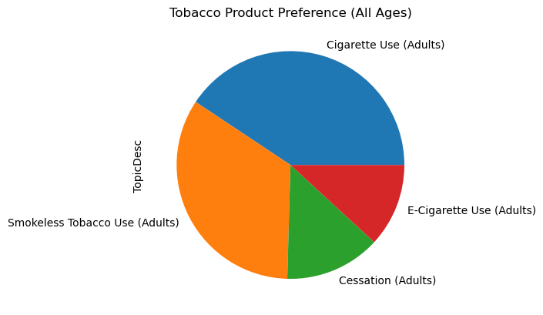
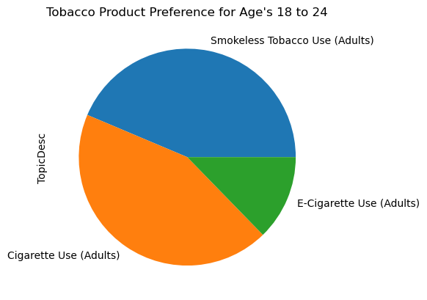
Tobacco Preference for younger adult's vs All Age’s
Cigarette Use (Adults) 8613 Smokeless Tobacco Use (Adults) 7179 Cessation (Adults) 2880 E-Cigarette Use (Adults) 2511
Smokeless Tobacco Use (Adults) 477 Cigarette Use (Adults) 477 E-Cigarette Use (Adults) 139

Slide 4
Tobacco Products vs Age- Conclusions
Younger American adults are not more likely to prefer other tobacco products vs cigarettes
Americans between the ages on 18-24 consume smokeless tobacco and cigarettes at the same rate
Age does not seem to be a strong correlation in tobacco preference based on the data we used.

Slide 5
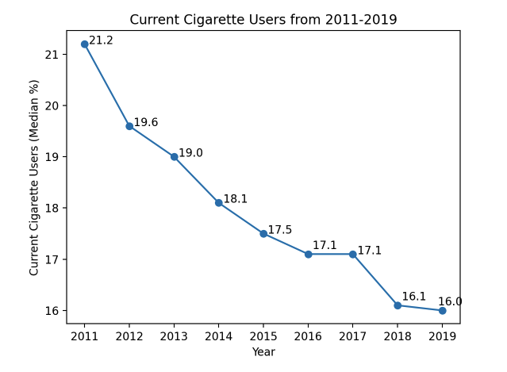
Tobacco Use Over Time - Cigarette
Cigarette use declined from 2011-2019.

Slide 6
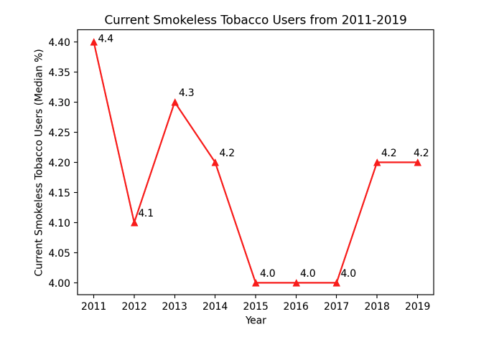
Tobacco Use Over Time - Smokeless
Smokeless tobacco use has not clearly trended in one direction from 2011-2019, and has remained low compared to cigarette use.

Slide 7
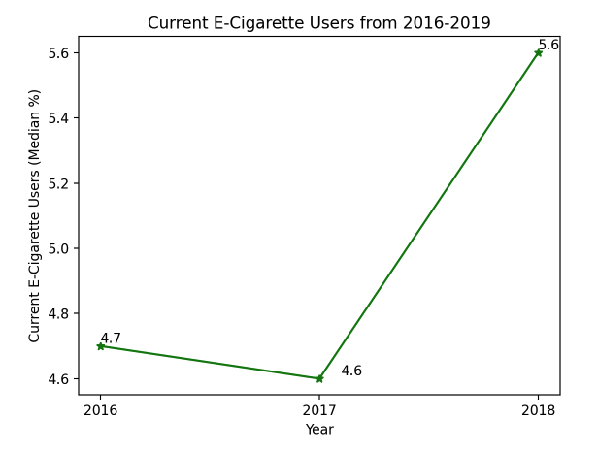
Tobacco Use Over Time - E-Cigarette
There is not enough data on e-cigarette use to determine a trend.

Slide 8
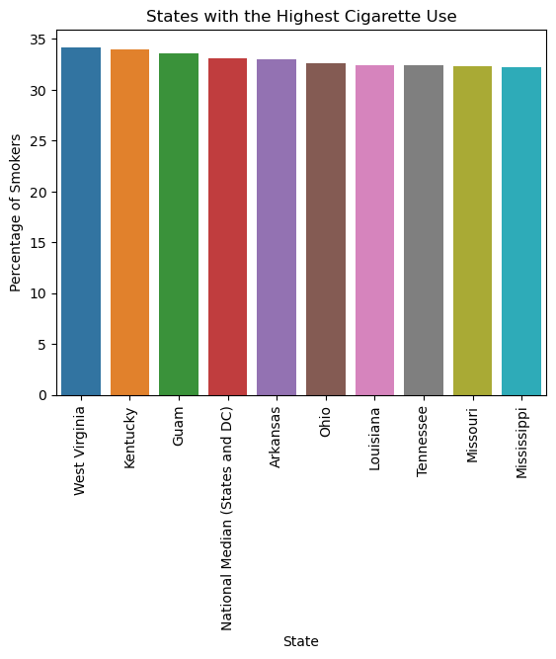
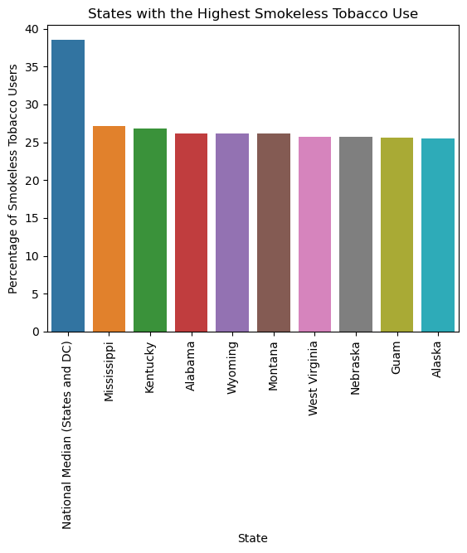
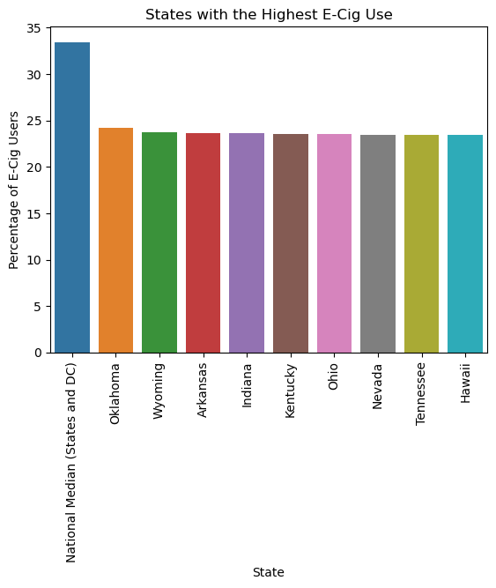
Top 10 States with Cigarette Use
Top 10 States with Smokeless Tobacco Use
Top 10 States with E-Cigarette Use

Slide 9
Conclusion
Cigarette(Adult) is the highest tobacco used among all states.
West Virginia has the highest percentage of cigarette smokers
National Median(States and DC) has the highest percentage of smokeless tobacco users and e-cig users.

Slide 10
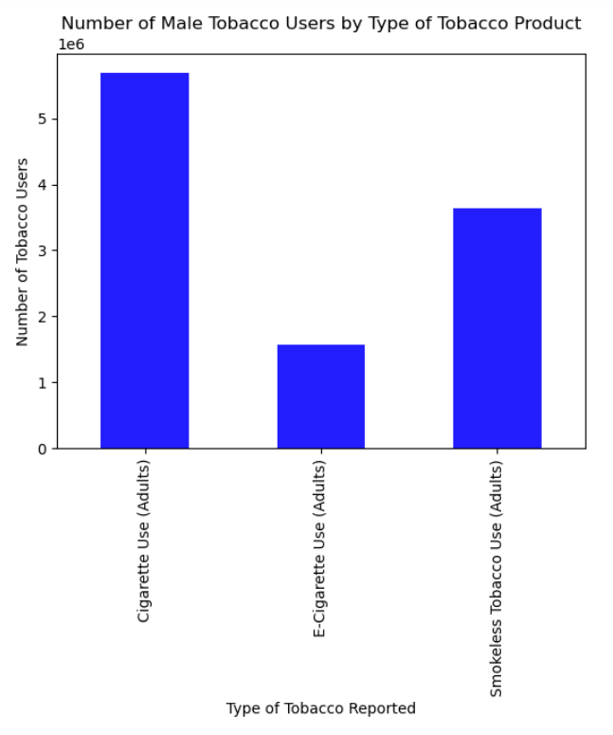
For the men reported in this data set, there were just over 5.6 million cigarette smokers, 3.6 million smokeless tobacco users, and 1.6 million e-cigarette smokers.
*number is reduced to ensure a graph that fits on a screen and is still legible

Slide 11
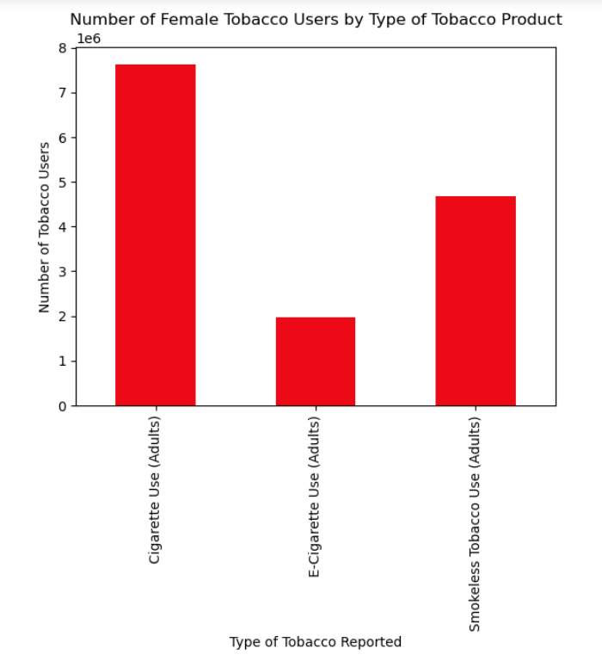
In total, there were 7.6 million cigarette smokers, 4.7 million smokeless tobacco users, and just under 2 million e-cigarette users
There were more women reported as cigarette smokers than in any category of men by 2 million people
*number is reduced to ensure a graph that fits on a screen and is still legible

Slide 12
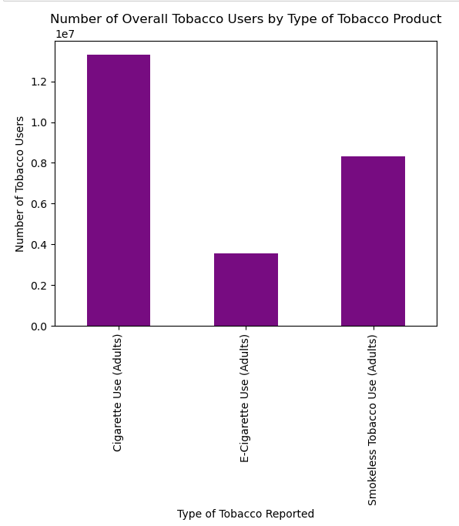
Overall, cigarettes are the most widely used form of tobacco between both genders. There were just over 13 million cigarette smokers reported throughout the US.
For both genders, e-cigarettes are used less than the other types of tobacco
Both genders had the same pattern of usage as cigarettes being the most prevalent, then smokeless tobacco, then e-cigarettes

Slide 13
Chi-Square Test
H0: There is no significant association between gender and cigarette use.
H1: There is a significant association between gender and cigarette use.
Critical Value = 3.84
Chi-Square Value = 65.64
65.64 > 3.84 so the results are statistically significant and we can reject the null hypothesis.

